Slide 1

A Learning-Based Framework for Influential Node Detection in Weighted Graphs. Honours Project Phase1 Review1
By
Albin John
2023BCD0005
Guided By,
Dr. Jisha Mariyam John

Slide 2
Outline
Introduction
Motivation
Literature Review
Research Gaps
Problem Statement
Objectives
Methodology
Architecture
Timeline
References

Slide 3
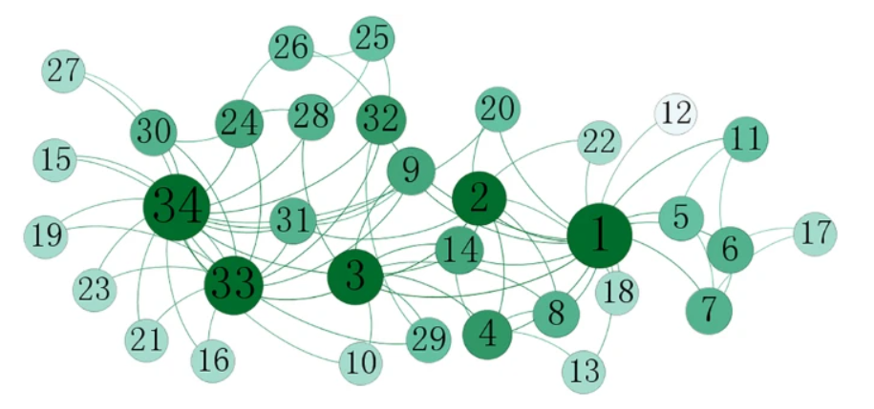
Introduction
Influential Node Detection
Complex systems such as social, biological, financial, and transportation networks are modeled as graphs. In complex networks, not all nodes contribute equally.
Some nodes play a critical role in:
Information diffusion
Epidemic spreading
Network stability
Chain-Reaction Effects
Identifying these critical nodes is known as Influential Node Detection.

Slide 4
Introduction
Why Efficient Influential Node Detection is Important?
Real-world networks are large and complex.
Simulating diffusion from every node requires heavy computation in large networks.
Accurate identification enables:
Targeted vaccination strategies
Effective viral marketing campaigns
Efficient resource allocation
Therefore, designing efficient influential node detection methods is a critical research problem in network science.

Slide 5
Motivation
Efficient influential node detection is crucial because a small number of nodes often control information spread, epidemic diffusion, and network stability in real-world systems.
In traditional centrality measures capture only limited structural aspects and often ignore edge weights[1]. Moreover, many existing Graph convolutional network-based approaches are primarily designed for unweighted networks [2],[3],[7].
Limitation 1: Centrality-only methods [1],[7].
Cannot capture multi-scale influence
Either local or global
Limitation 3: Robustness Issues [4].
GNN sensitive to topology changes
Limitation 2: Many works focus on unweighted graphs [2], [3].
Edge strength often ignored

Slide 6
Motivation
Since real-world networks are inherently weighted, there is a strong need for efficient and robust influential node detection methods that incorporate edge strength information.
Why Use GCN for Influential Node Detection?
Captures Structural Dependencies [6].
GCN aggregates information from node neighborhoods.
Learns both local and global structural patterns.
Overcomes Limitations of Centrality Measures [1].
Centrality methods rely on fixed mathematical formulations.
GCN learns influence patterns automatically from data.
Proven Effectiveness in Node Influence Tasks.
Hybrid centrality + GCN improves influence prediction [4].
Structural equivalence + GCN improves node ranking [3].
CNN-GNN hybrid enhances influence modelling [2].
Scalable & Representation Learning-Based [6].
Learns low-dimensional embeddings
Handles large complex networks efficiently.

Slide 7
Literature Review
Paper | Method Type | Key Idea | Limitation
Detection of Influential Nodes Using Network Metrics [5] | Centrality-Based | Uses Degree, Closeness, PageRank, Eigenvector for influence detection | Purely structural, no learning mechanism
Comparative Analysis of Centrality Measures (GDK) [1] | Hybrid Centrality | Combines Global Structure Model + Degree + K-shell (GDK) | Not learning-based, limited scalability
Key Node Identification based on Hybrid Centrality and GNN (NLGCN) [4] | GCN-Based (Hybrid) | Combines mixed centrality features with GCN; multi-channel + attention mechanism | Designed mainly for unweighted graphs

Slide 8
Literature Review
Paper | Method Type | Key Idea | Limitation
SE_GCN: Structural Equivalent Key Nodes Identification [3] | GCN-Based | Uses structural equivalence features with GCN for node ranking | Binary adjacency assumption (unweighted)
Hybrid CNN-GNN (CGCAN) [2] | Deep Learning (CNN + GCN) | Combines CNN-based neighborhood encoding with GCN | Uses unweighted adjacency matrix
Graph Convolutional Networks: A Comprehensive Review [6] | Theoretical Survey | Explains spectral & spatial GCN models | Not specific to influence detection
Identifying Influential Nodes in Complex Networks [7]. | Centrality-Based Method (Semi-Local / Local Centrality Measure) | Proposes a semi-local centrality measure that considers nearest neighbors to balance accuracy and efficiency. | Designed for undirected networks. Does not incorporate edge weights

Slide 9
Research Gaps
Based on literature:
Most models designed for unweighted graphs
Adjacency defined as binary [2],[3],[7].
2. Hybrid centrality methods exist, but integration with weighted structural learning is limited [4].
3. Limited exploration of edge-weight-aware graph convolution
Lack of comparative study for weighted influence modeling.
Gap: No dedicated weighted-GCN framework for influential node detection.

Slide 10
Problem Statement
Design a learning-based framework to:
Identify influential nodes
In weighted complex networks
Using Graph Convolutional Networks
While leveraging edge-weight information effectively

Slide 11
Objectives
To develop a learning-based framework for identifying influential nodes in weighted complex networks.
To incorporate edge-weight information into graph convolution operations to capture structural dependencies effectively.
To model multi-scale influence patterns by integrating both local and global structural features.
To evaluate the proposed approach against traditional centrality measures using ranking correlation and diffusion-based validation metrics.

Slide 12
Methodology
Step 1: Data
Weighted adjacency matrix
Node feature extraction
Step 2: Feature Design [4]
Weighted degree
Weighted local-global metrics
Step 3: Weighted GCN Layer [6]
Modify adjacency normalization
Incorporate edge weights
Step 4: Influence Prediction
Fully connected regression layer
Step 5: Evaluation
Kendall Tau Correlation
SIR Model comparison

Slide 13
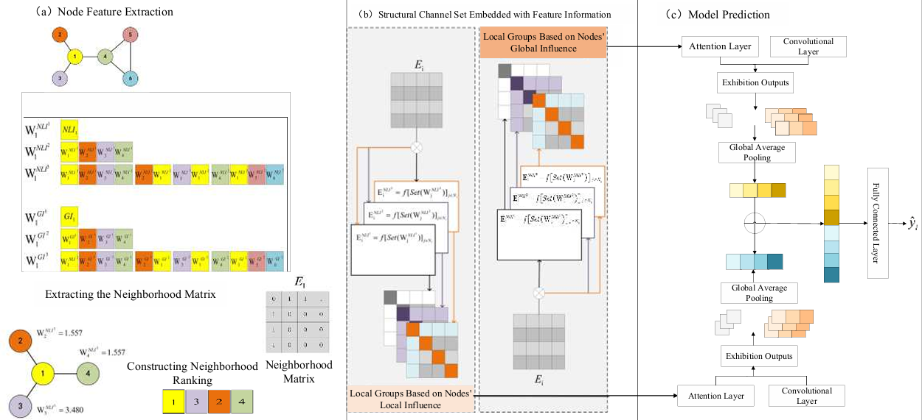
Architecture
Basic Framework of Neighborhood Local Graph Convolutional Network [4].

Slide 14
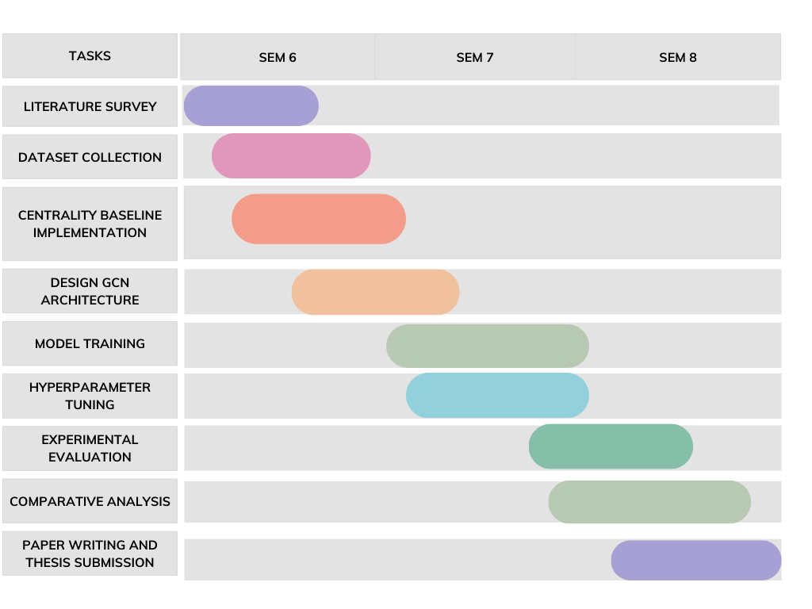
Timeline

Slide 15
References
[1] M. Mukhtar et al., “Comparative analysis of networks' centrality measures with ANOVA,”
Mathematical Modeling and Computing, 2025.
[2] D. Tu, F. Yang, X. Tang, J. Xie, and Z. Tao, “Identifying influential nodes in complex networks based on
a hybrid CNN-GNN approach,” in Proc. 4th Int. Conf. Electronic Information Engineering, Big Data and
Computer Technology (EIBDCT), Qingdao, China, 2025.
[3] A. Patel and B. Singh, “Graph convolutional network for structural equivalent key nodes identification
in complex networks,” Chaos, Solitons & Fractals, vol. 196, 2025.
[4] F. Guo, B. Cao, J. Sun, et al., “Key node identification method based on hybrid centrality and graph
neural network,” Research Square, Preprint, Jan. 2026

Slide 16
References
[5] A. Farooq, G. J. Joyia, M. Uzair and U. Akram, "Detection of influential nodes using social networks
analysis based on network metrics," 2018 International Conference on Computing, Mathematics and
Engineering Technologies (iCoMET),2018.
[6] Si Zhang1, Hanghang Tong, Jiejun Xu and Ross Maciejewski, A. Comprehensive Review Paper
(GCN Survey), “Graph Convolutional Networks: A Comprehensive Review,” Comput Soc Netw. 2019.
[7] D. Chen, L. Lü, M.-S. Shang, Y.-C. Zhang, and T. Zhou, “Identifying influential nodes in complex networks,”
Physica A: Statistical Mechanics and its Applications, vol. 391, 2012.

